Slide 1
Bank Data Ops
Notes:
Please copy/paste the Discover logo from the Cover layout master slide (see: View > Slide Master).

Slide 2
Agenda
Executive Summary
Cloud Data Platform Strategy
Deposits Data Ops Overview and Initiatives
Notes:
Placeholder: Introduction slide.

Slide 3
Executive Summary
We have staffed dedicated leadership roles to ensure we are well-managed in all aspects of data operations
We are developing foundational data services in the Cloud to provide more robust data capture and ingestion, more robust analytics and visualization, and model training and execution
The emerging platforms are being hardened and internal process refined to mitigate business risk
Our current delivery balances focus on foundational/enterprise initiatives with business-driven demand
As we align our business and tech strategies we will move towards real-time data capabilities, including data ingestion and decisioning
Notes:
Placeholder: Introduction slide.

Slide 4
Origin of Our Data Platform Strategy
Notes:
Placeholder: Introduction slide.

Slide 5
Introducing Our New 3CM Framework on the Cloud
Capture | > | Curate |  | > | Consume
Data Ingestion |  | Data Lake & Warehouse |  |  | Data Analytics & Modeling
Event Streaming |  | Realtime Operational Data Store |  |  | Visualization
 |  | Data Preparation |  |  | Decision & Strategy
 |  | Data Standardization |  |  | Model APIs
Management
Data Management |  |  | Data Protection
Data Governance |  |  | Infrastructure as a Service

Slide 6
High-Level Cloud Data Platform Architecture

Slide 7
Cloud Data Platform 2019 Roadmap
Cloud Data & Platform Foundation | Platform Hardening | New Capabilities
JAN–APR 2019 | MAY–AUG 2019 | SEP–DEC 2019
Cloud Foundational Platforms S3 Data Lake Snowflake DW ZIPLINE Model training platform Model execution platform (Openshift) BI (Tableau) RDS (Postgres) | Critical Platform Hardening Data backup and restore hardening S3 data move to prod and restricted accounts Access controls and automation Cost and resource optimization Openshift capacity expansion Model governance using JIRA | New Capabilities/Pilots ETL on Cloud pilot DR (AWS West) build Real-time data platform Self-service/smarter resource provisioning and consumption 99.9% platform resiliency
Data Batch data patterns from TD and Ab Initio to SF Prod data copied to SF Alation Data Catalog | Data Patterns to address “data insufficiency” (Hadoop, SAS) Harden Batch data patterns DQ platform (Abi DQE) | Data Real-time data patterns
Tech Debt Ab Initio AIX to Linux migration | Tech Debt SAS Grid re-platform Ab Initio GPFS to NFS migration | Tech Debt Aster re-platform

Slide 8
DEPOSITS Data Ops

Slide 9
Bank data Ops Team Structure

Slide 10
Strategic Enterprise Technology Initiatives
Feature | Value
Hadoop Migration | Implement a consolidated common architecture for all of bank data and migrate all the data, users, applications and processes from Hadoop to Snowflake. This will help move the DSL data assets , bank fraud and some of the enterprise decision models, towards the target state architecture and set the stage for advanced analytics capabilities in the near future.
FODS Decommission | Move the Deposits data assets towards target architecture to set stage for advanced analytics capabilities, and improve SLAs, scalability and resiliency
California Consumer Privacy Act | The California Consumer Privacy Act will grant significant new privacy rights to California residents, including the right to request access to personal information, disclosure of personal information, deletion of personal information, and opt-out of sale/transfer of personal information from businesses that meet a certain threshold. Violation of the CCPA is subject to a private right of action related to specific data breach scenarios, as well as civil penalties enforced by the California Attorney General.
SLA Dashboard Improvements | Improve monitoring capabilities and provide improved insights into availability, performance, timeliness, and accuracy of the analytical systems and data that support the Deposits business value streams.
AIX to Linux Server Migration (Completed) | Consolidate and refresh entire ET platform from legacy AIX to Linux platform, allowing for future functionality and growth.
Teradata to AWS Migration (Completed) | Migration of all existing Teradata data to AWS environment for Analytics, allowing for future growth and improved business capabilities.

Slide 11
Deposits Value Stream Alignment
Feature | Value
High Net Worth Strategy | Account for different money movement patterns among our population of customers with high deposits balances. This will provide an opportunity to better meet their needs through minor modifications, which will reduce the risk of attrition on these balances.
Zelle P2P | Enable new person-to-person payment functionality on web and mobile.
Migration of SAS Fraud Strategies | Provide efficiencies within business processes and avoid process failures, resulting in more timely fraud actions and prevention.
Project Taylor— Savings Product Differentiation | Enhance features or possibly launch entirely new savings product to differentiate in marketplace; will function like an OSA account with additional features such as automated internal transfers from checking to savings.
RHEL— Finacle to Linux Server Migration | Consolidate and refresh entire Infosys Finacle Core Banking platform from legacy AIX to RHEL platform, allowing for future functionality and growth.
6-Day Batch | Transition bank batch processing from a 5-day bank working day calendar to a 6-day processing calendar (Sunday–Friday) to allow more frequent and consistent operations weekly (6 days/week), allowing for improved cost savings related to collections processing.

Slide 12
DPL Value Stream Alignment
Feature | Value
Credit Zest | Enable Credit zest to receive the score on every application that passes the pre bureau decline process within the current decision engine
Simility Data Lake | customer fraud data in DFS data lake so that we can look for patterns and create new fraud rules
Nuestar Leads Audience | Allow re-targeting with Neustar to go live, $10MM originations annual
Re-engagement Strategy | Enhance the DPL reengagement credit strategy through utilizing DPL PRS which has better risk differentiation for list selection and underwriting
Return Payment Representment | Simulate card process for Representment for DPL and DSL in Finacle, creating one Representment for one more attempt to collect payment on NSF return payments (ACH, Internal Transfer).
RHEL— Finacle to Linux Server Migration | Consolidate and refresh entire Infosys Finacle Core Banking platform from legacy AIX to RHEL platform, allowing for future functionality and growth.
6-Day Batch | Transition bank batch processing from a 5-day bank working day calendar to a 6-day processing calendar (Sunday–Friday) to allow more frequent and consistent operations weekly (6 days/week), allowing for improved cost savings related to collections processing.

Slide 13
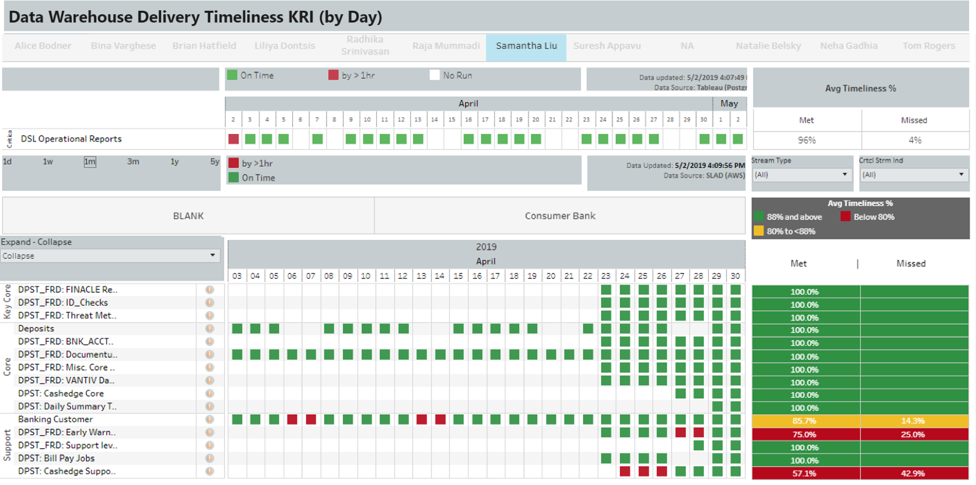
SLA/SLO Dashboards for Deposits Applications

Slide 14
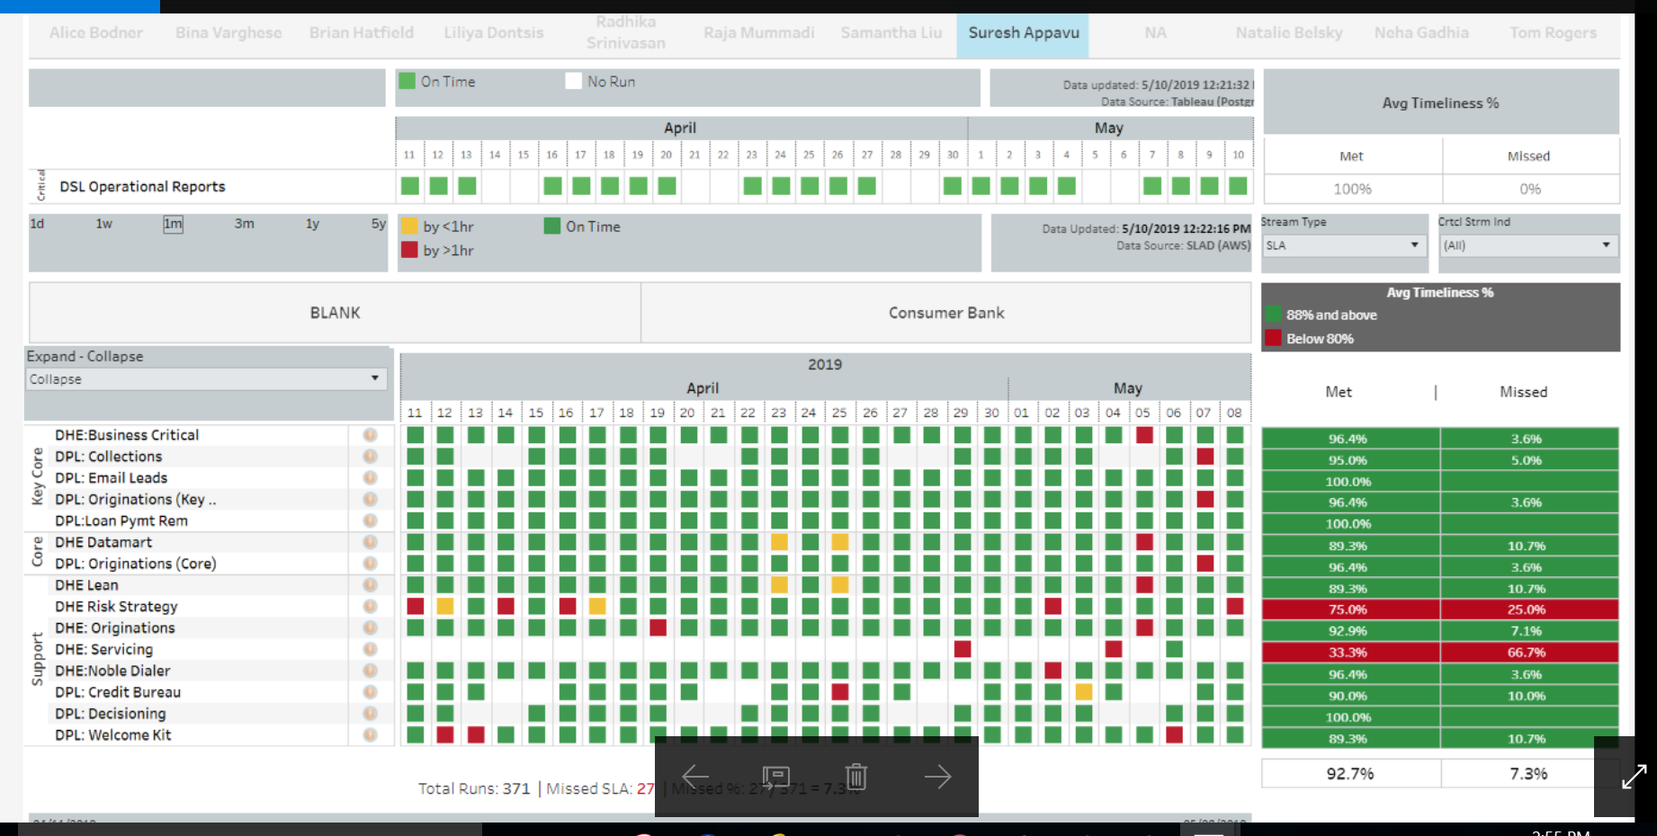
SLA/SLO Dashboards for DPL Applications

Slide 15
April Improvements
Internal DQ improvements
Schedule improvements
Production Incident Reduction

Slide 16
Appendix

Slide 17
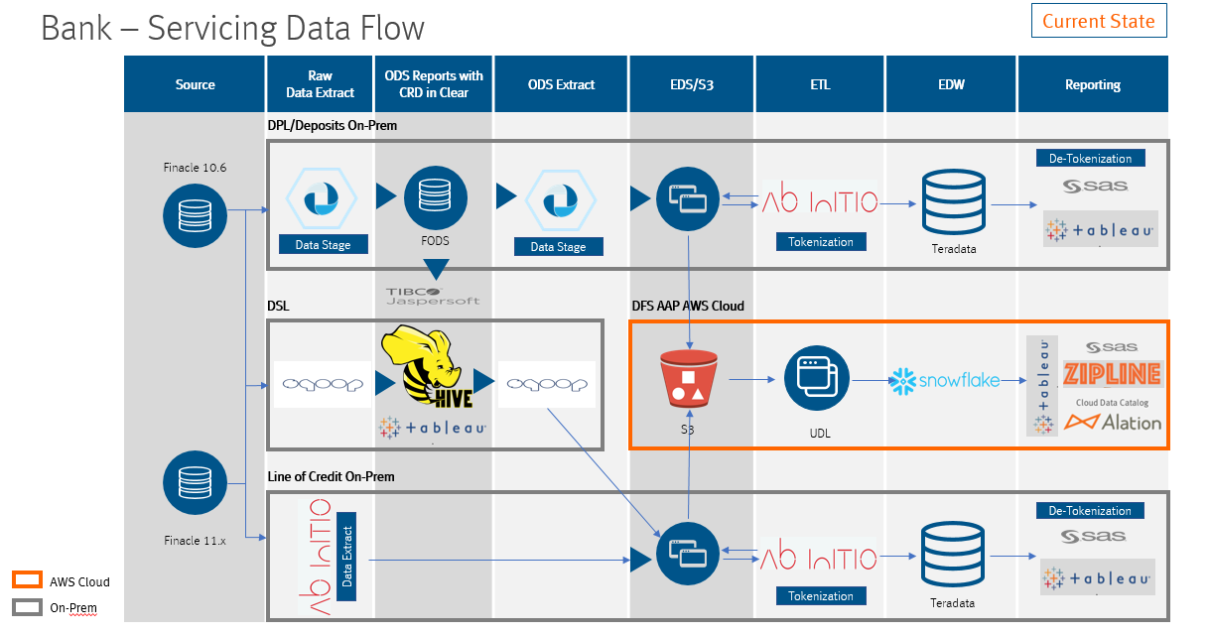
Bank Servicing—Current Architecture

Slide 18
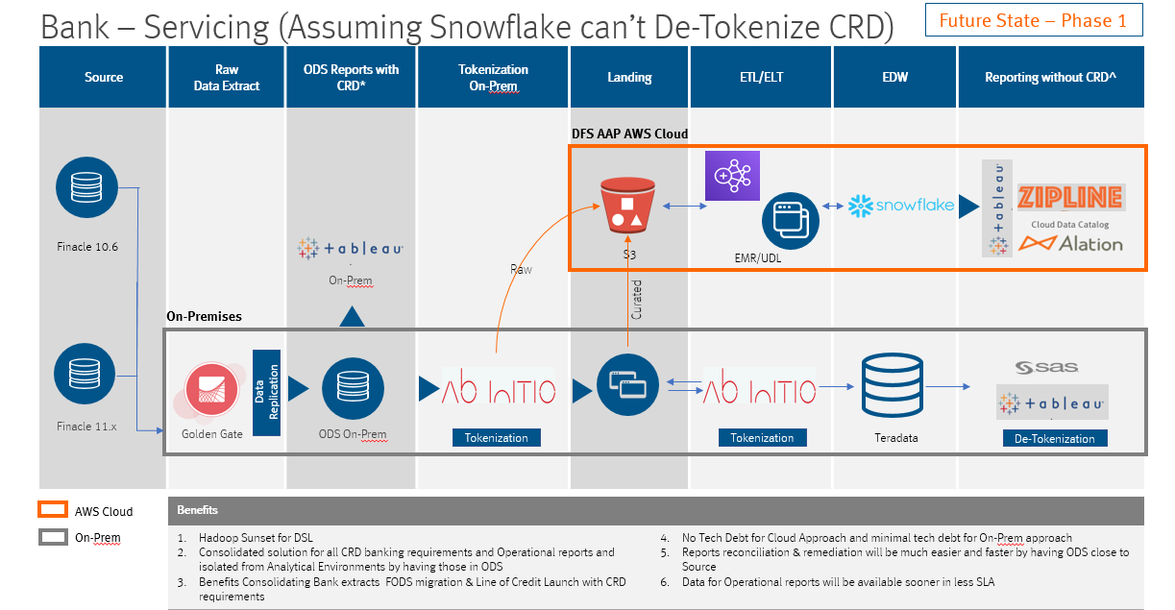
Bank Servicing—Architecture with ODS

Slide 19
Bank Servicing—Target Architecture

Slide 20
Hadoop and FODS Migration—Business Value
Hadoop Migration
Platform consolidation for all end users to go to one place for all of their data needs by early 2020
Leveraging a standard process of data flow for all of bank
Efficiencies will be gained by leveraging the work done through Hadoop migration and LOC for FODS migration
Final migration to AWS will be simplified by the work done to move the processes to Ab Initio and reports to Teradata/Snowflake
If CRD/detokenization and ODS capabilities are developed by then, we can directly migrate to the cloud within this timeframe
FODS Migration
Leveraging a standard process of data flow for all of bank
Efficiencies will be gained by leveraging the work done through Hadoop migration and LOC for FODS migration
Final migration to AWS will be simplified by the work done to move the processes to Ab Initio and reports to Teradata/Snowflake
Move all the reports to target state tools (Tableau)
Decommission FODS servers and technologies that have reached end-of-life and are no longer supported

